Slide 1

Intermediate Presentation
Fangzhou Chen
Jiacong Li
Marco Hoogesteger
Martijn Crombeen
Group 1

Slide 2
Contents
Current situation
Updated vision
Thrust test
Speed test
Expectations

Slide 3
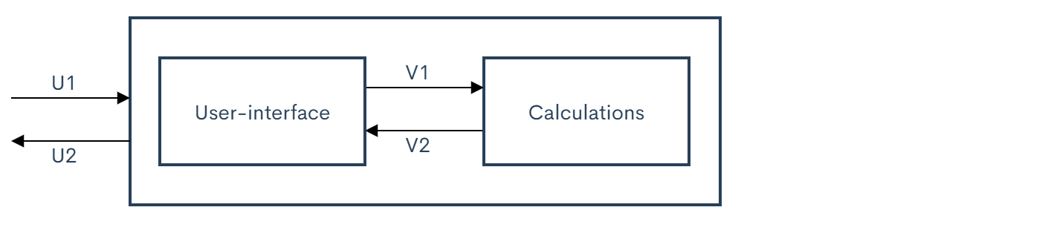
Current situation
Designed demo
Research
Subsystem design
Formulas
Plan B
Contact with Tom Reitenbach
Design phase

Slide 4
Updated vision
Digital twin
Inputs
Outputs
Verification

Slide 5
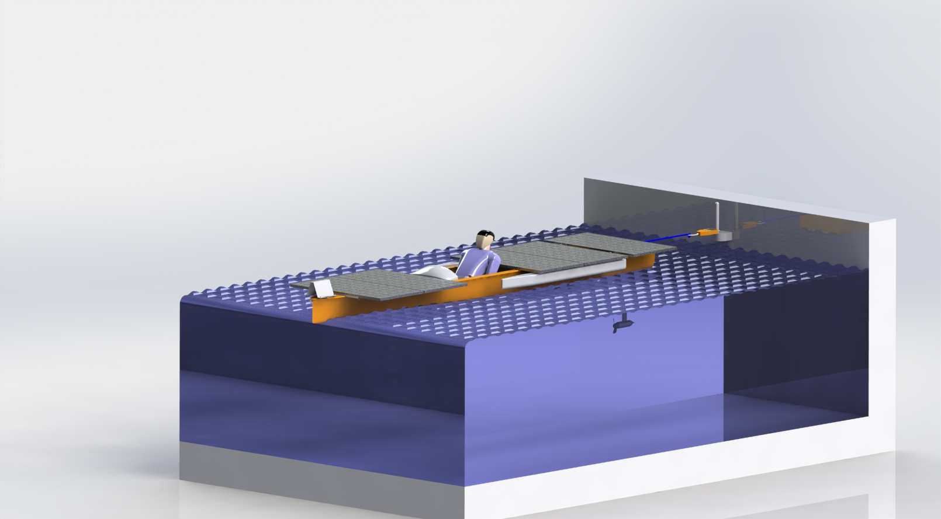
Thrust test
Anker to coast
Hanging scale
Force
Steps on input

Slide 6
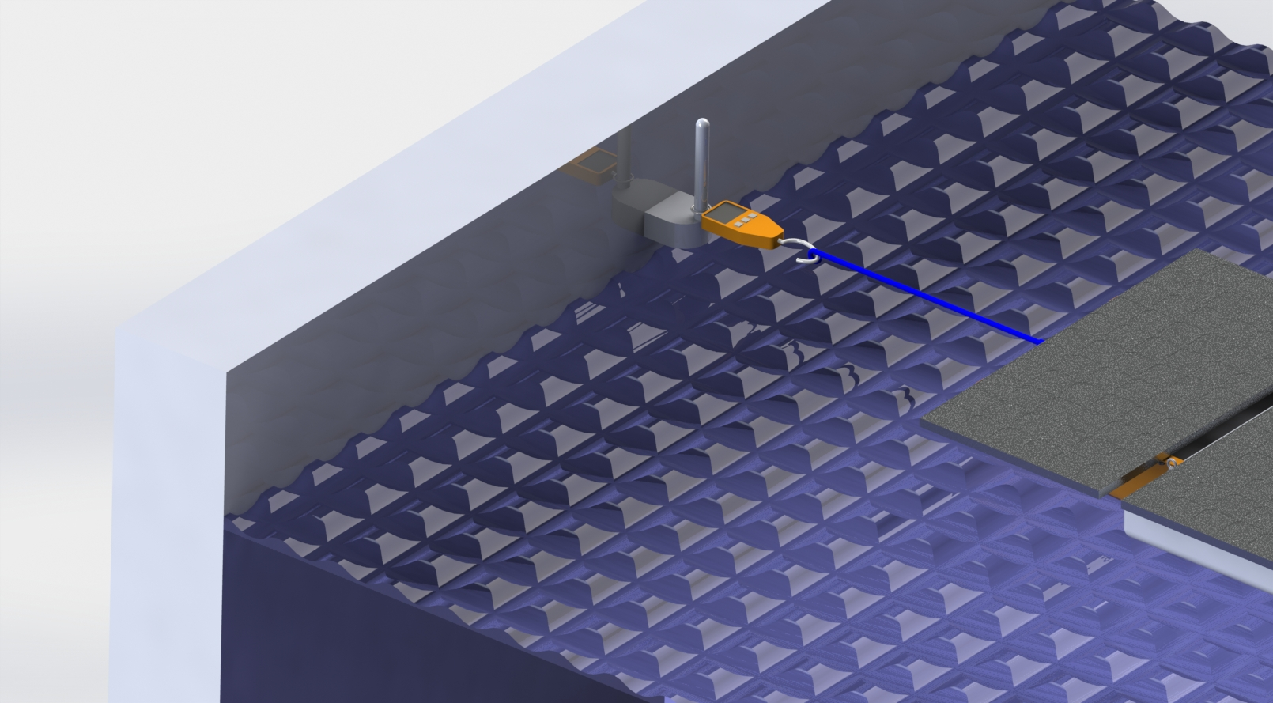
Thrust test
Anker to coast
Hanging scale
Force
Steps on input

Slide 7
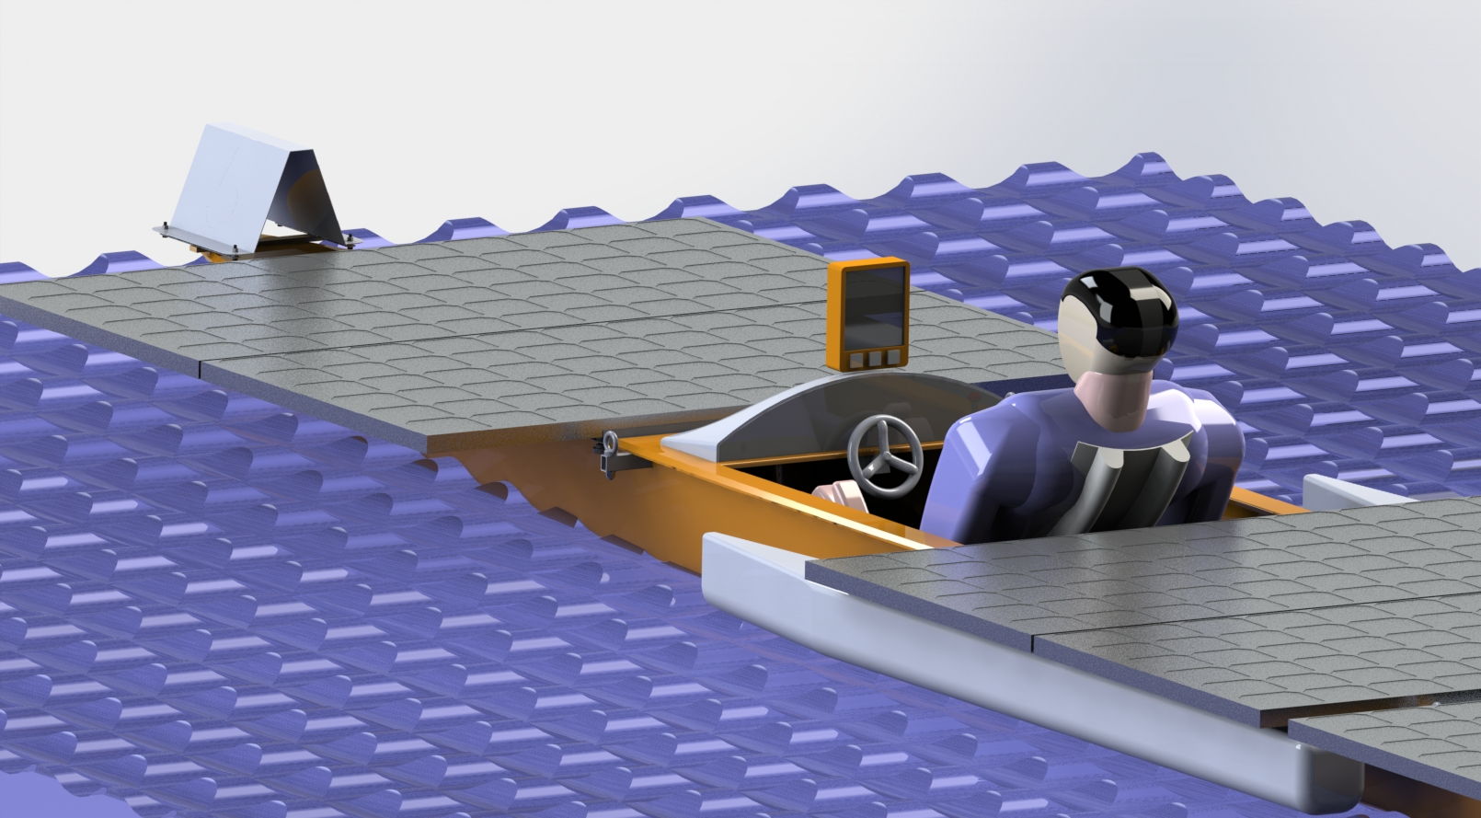
Speed test
Sail
Different speeds
Steps on input voltage
GPS

Slide 8
Future progress
Meeting 30-10-2020 boat
Future meetings
Real experiments
Design interface

Slide 9
Questions?
Thank you for your attention!

